Slide 1
Intro to html
MCNDHS
Ms. Eng

Slide 2
aim: What are structural markup tags?
Do now:
If you missed any previous lectures and would like to catch up:
Step 1:
log into your pupil path account,
Step 2:
Click on your programming class
Step 3:
Find the lectures labeled : Lecture 1: intro to html…. etc
Daily Grade:
On-time/attendance/not leaving the classroom: 25%
Cellphones: 25%
Notes:25%
Classwork/Homework: 25%

Slide 3
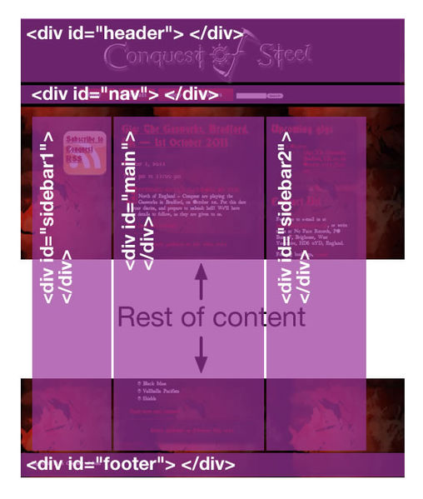
this unit: Structural markup
What is structural mark up?
Structural mark up:
HTML that affects the location of your text, images, forms,..etc.

Slide 4
from last week:
<!DOCTYPE html>
<html>
<head>
<title>Title of your website</title>
</head>
<body>
<h1>Heading</h1>
<p>something something</p>
</body>
</html>
Index.html
For this week, we will be focusing between
<body></body>

Slide 5
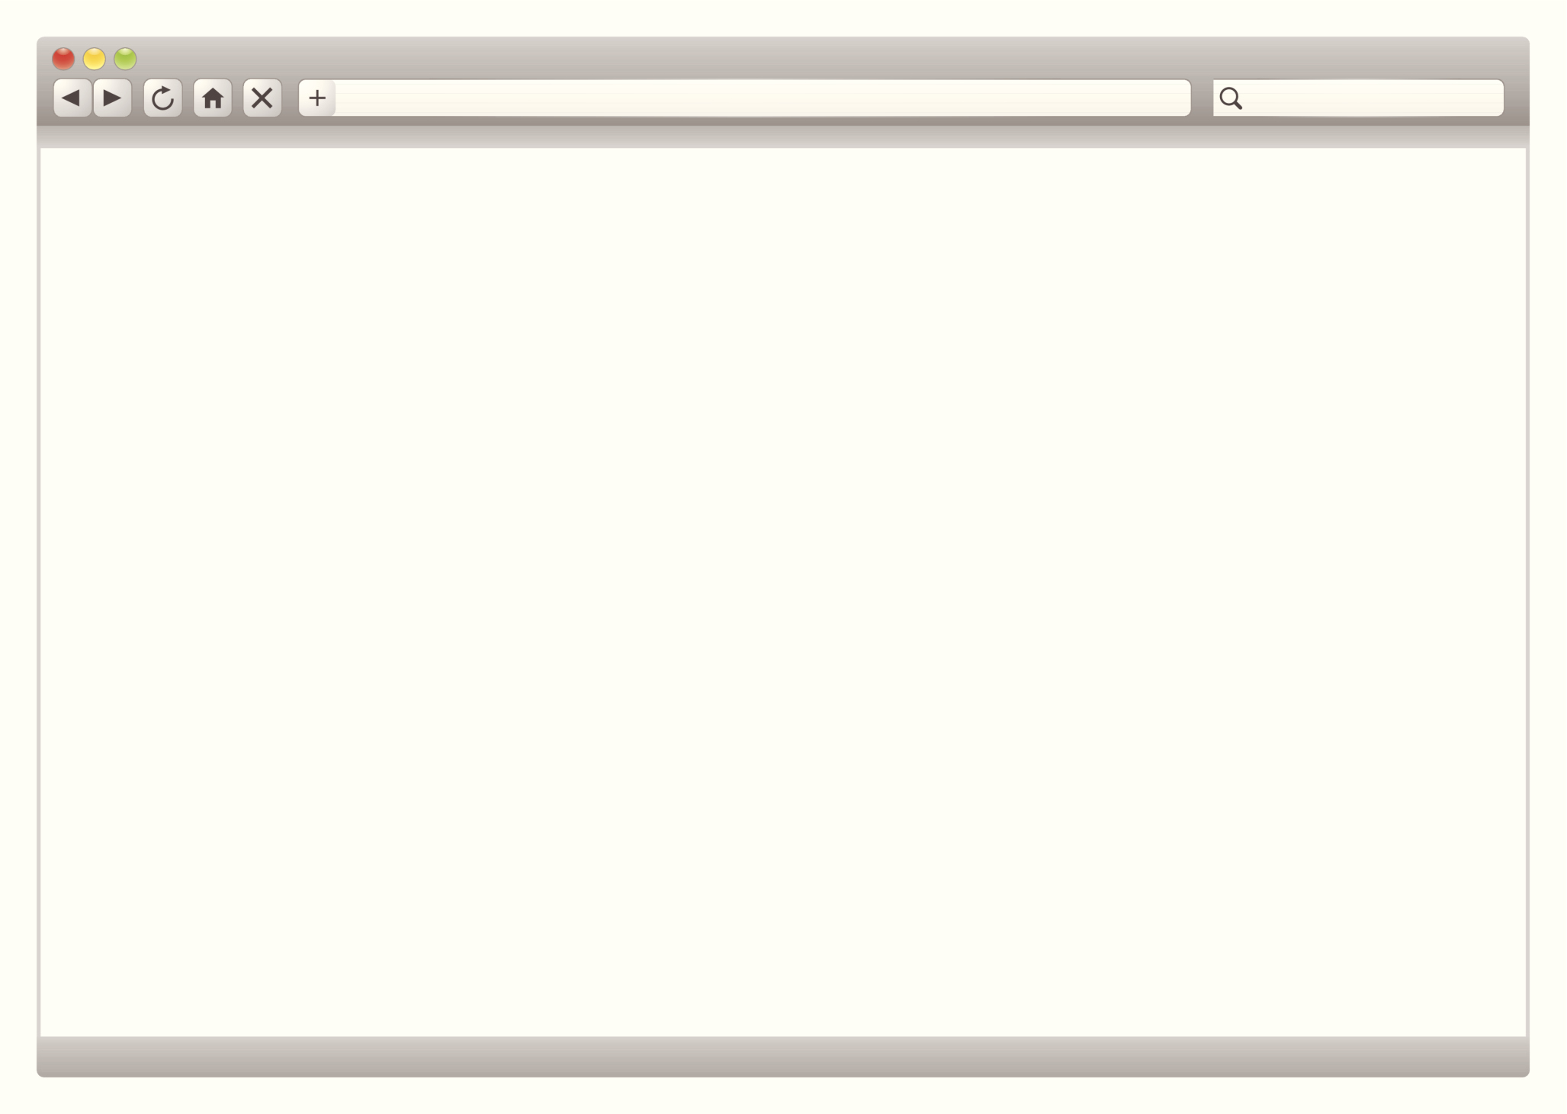
what happens between <body></body>?
All the content that you “see” belongs in-between
<body>
</body>

Slide 6
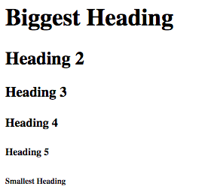
heading tag
<h1>Biggest Heading</h1>
<h2>Heading 2</h2>
<h3>Heading 3</h3>
<h4>Heading 4</h4>
<h5>Heading 5</h5>
<h6>Smallest Heading</h6>
Biggest heading <h1></h1>
Smallest heading <h6></h6>
Critical question: Why not just change the font size? (think about the main focus of this unit)

Slide 7
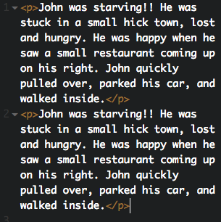
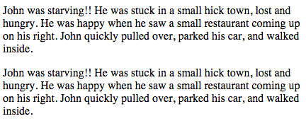
Paragraph tag
tag: <p></p>
description:
This tag is to break up chunks of text.
The result between each paragraph will have only one line of space.

Slide 8
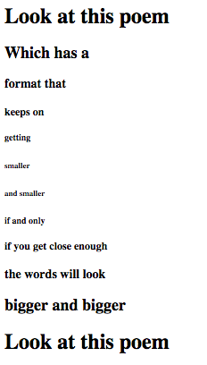
activity
Question 1: 50%
using only the heading tag, create the following:
Question 2: 50%
Using the paragraph tag, type five sentences about your day.

